Slide 1
AJAX Introduction with jQuery
C273 – Advanced Web Application Development in PHP

Slide 2
What is AJAX?
Asynchronous JavaScript and XML.
Not a stand-alone language or technology.
It creates faster, more interactive and user friendly web pages.

Slide 3
3 Purpose of ajax
Prevents unnecessary reloading of a page.
When we submit a form or refresh a page, the whole page is typically reloaded from the server. This causes very long waiting times and waste of bandwidth.
AJAX aims at loading only the necessary information and making only the necessary changes on the current page without reloading the whole page.

Slide 4
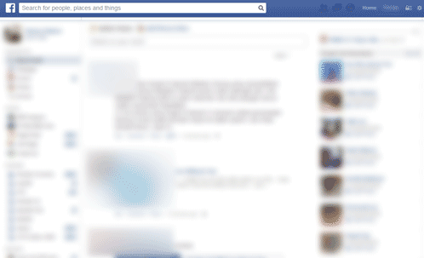
AJAX on facebook
Facebook Wall uses AJAX to auto-load the older posts without the need for you to reload the entire page.

Slide 5
3 Technologies Used
AJAX makes use of:
jQuery / JavaScript (for page altering)
JSON / XML (for data exchange)
PHP / ASP / JSP (server side) is used for creating the web service
Note: This module will be using jQuery, JSON and PHP.

Slide 6
JSON (JavaScript Object Notation)
Lightweight data-interchange format
Transmit data between a server and web application
Alternative to XML
2 forms
Object
{"age" : "24","hometown" : "Missoula, MT","gender" : "male"}
Array
[{"name" : "Jason","age" : "24","gender" : "male"},{"name" : "Kyle","age" : "21","gender" : "male"}]

Slide 7
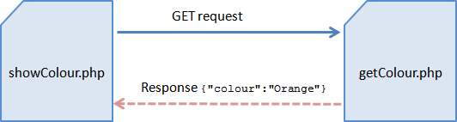
AJAX & JSON
Step 3: JSON message is sent back as response
Step 2: PHP Web Service processes the request
Step 1: Web page sends a HTTP GET request using AJAX

Slide 8
PHP: json_encode
PHP includes the following global function for interacting with JSON data:
json_encode(object) | returns JSON equivalent for the given object or array or value

Slide 9
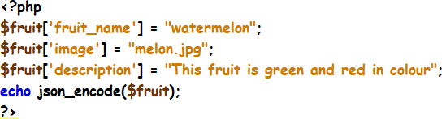
Exercise 1a
PHP webservice 1a_getFruit.php:
JSON response

Slide 10
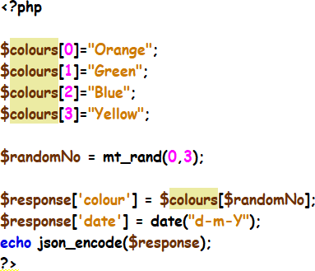
Exercise 1b
Create a PHP webservice that displays a random colour from 4 colours “Orange”, “Green”, “Blue” and “Yellow” and also the current date.
A sample JSON response:

Slide 11
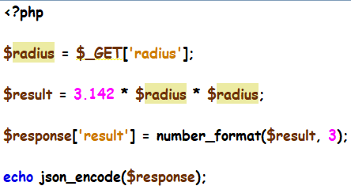
Exercise 1c
Create a PHP file called 1c_getCircleResults.php that calculates the area of a circle (area = 3.142 x radius x radius) given the radius as a parameter.
A sample request to this webservice: http://localhost/C273_L07Ajax/1c_getCircleResults.php?radius=5 will produce the following JSON response:

Slide 12

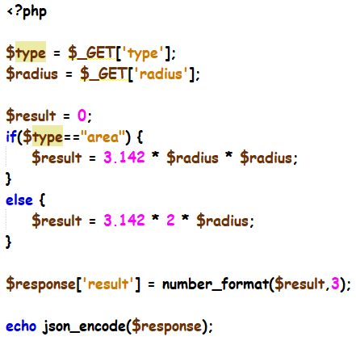
Exercise 1c: continue
Receive another parameter “type”. If the type is “area”, calculate the area of a circle. Otherwise if the type is “perimeter”, calculate the perimeter of a circle (3.142 x 2 x radius)
A sample request to this webservice: http://localhost/C273_L07Ajax/1c_getCircleResults.php?radius=5&type=perimeter will produce the following JSON response:

Slide 13

Exercise 1d
Create a PHP file called 1d_getCalorieResults.php.
Receive 4 parameters “age”, “gender”, “height” and “weight”.
Calculate the calorie per day using the BMR formula below:
Test http://localhost/C273_L07Ajax/1d_getCalorieResults.php?age=21&gender=M&hei ght=170&weight=65 from your browser and you should get the JSON response:

Slide 14
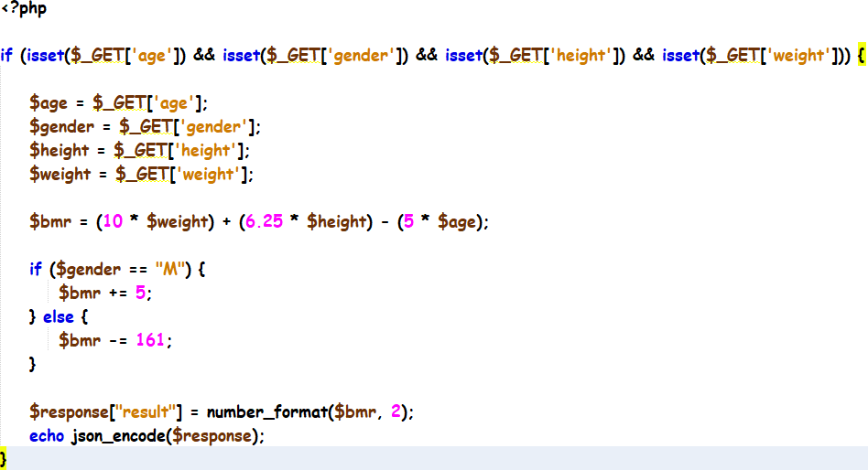
Exercise 1d: solution

Slide 15
Recap mysqli functions
Function | Description
mysqli_connect() | Opens a new connection to the MySQL server
mysqli_query() | Performs a query against the database
mysqli_fetch_array() | Fetches a result row as an associative, a numeric array, or both
mysqli_fetch_assoc() | Fetches a result row as an associative array
mysqli_fetch_row() | Fetches one row from a result- set and returns it as an enumerated array
mysqli_close() | Closes a previously opened database connection

Slide 16

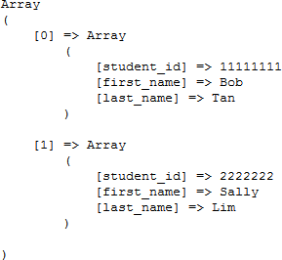
Recap PHP Associative arrays
An associative array uses text as keys
A 2-dimensional associative array
Always use mysqli_fetch_assoc to retrieve data from database so that the json_encode function is able to encode the data into name-value pairs

Slide 17
JSON encoded data
json_encode
{"student_id":"11111111","first_nam e":"Bob","last_name":"Tan"}
[{"student_id":"11111111","first_ name":"Bob","last_name":"Tan"},
{"student_id":"2222222","first_na me":"Sally","last_name":"Lim"}]
json_encode

Slide 18
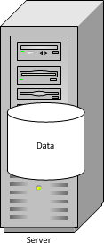
Exercise 2a
PHP web service 2a_getCategories.php
Http request
mysqli_query
JSON Response: [{"id":"1","name":"Orchids"},
{"id":"2","name":"Peas"}]

Slide 19
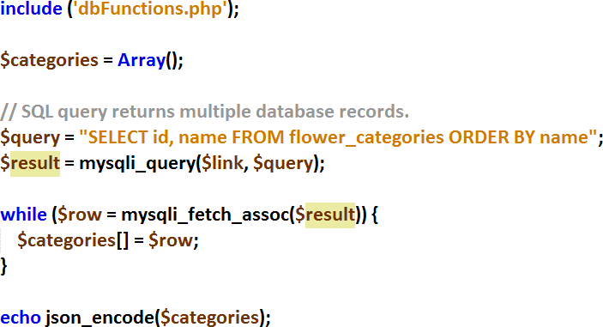
Exercise 2a
Step1: Write the select
query to retrieve data from the flower_category table
Step2: Execute the query using mysqli_query function
Step3: Use mysqli_fetch_assoc function to retrieve the table rows and store into
$categories
Step4: Use json_encode function to encode the array into JSON format and echo the output

Slide 20

Exercise 2b
Create a PHP file called 2b_getFlowers.php
Retrieve data from the database table flowers for the particular category
use $_GET to extract the cat_id from the Http GET request URL.
Test getFlowers.php webservice by executing the following: http://localhost/C273_L07Ajax/2b_getFlowers.php?cat_id=1 You should get the following output:

Slide 21
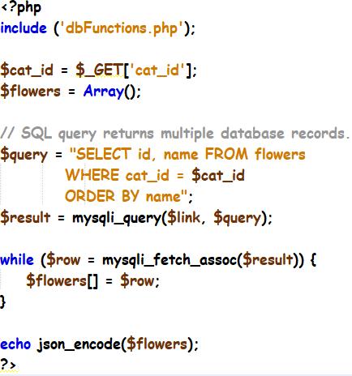
Exercise 2b: solution

Slide 22
Exercise 2c
Create a PHP file called 2c_getFlowerDetails.php
Retrieve data from the database table flowers for the particular flower
use $_GET to extract the f_id from the Http GET request URL.
Test the webservice by executing the following: http://localhost/C273_L07Ajax/2c_getFlowerDetails.php?f_id=1 You should get the following JSON response:

Slide 23
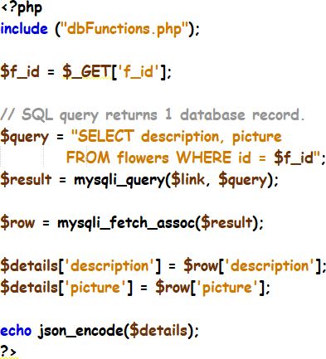
Exercise 2c: solution

Slide 24
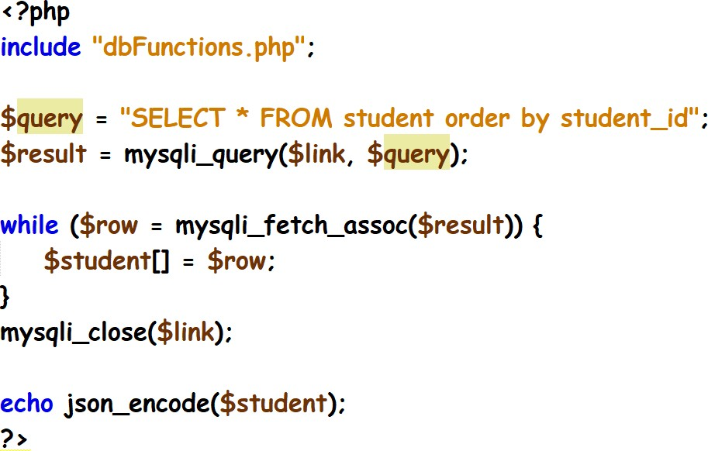
Exercise 3a
Create a PHP file called 3a_getStudents.php
Retrieve all data from the database table student
Test it by executing the following: http://localhost/C273_L07Ajax/3a_getStudents.php You should get the following JSON response:

Slide 25
Exercise 3b
Create a PHP file called 3b_getStudentsByModule.php
Retrieve all data from the database table student based on the module (hint: You need to write a SQL join between tables student
and allocation.)
Test it by executing the following: http://localhost/C273_L07Ajax/3b_getStudentsByModule.php?mo dule_code=c207
You should get the following JSON response:

Slide 26
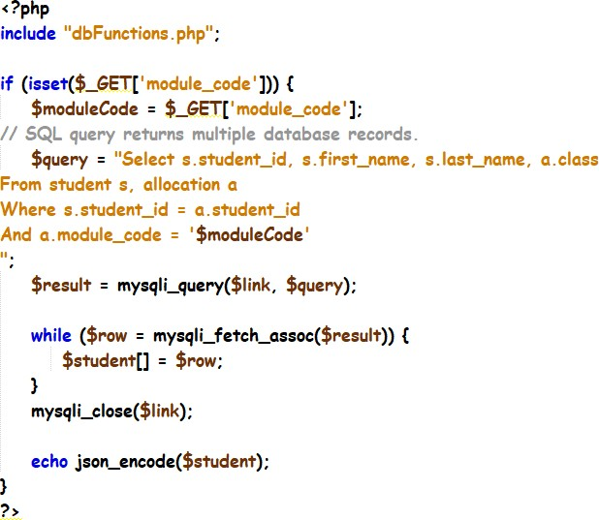
Exercise 3b: solution

Slide 27
Exercise 3c
Create a PHP file called 3c_getStudentDetails.php
Retrieve all data from the database table student based on the student id
Test it by executing the following: http://localhost/C273_L07Ajax/3c_getStudentDetails.php?stude
nt_id=1111111
You should get the following JSON response:

Slide 28
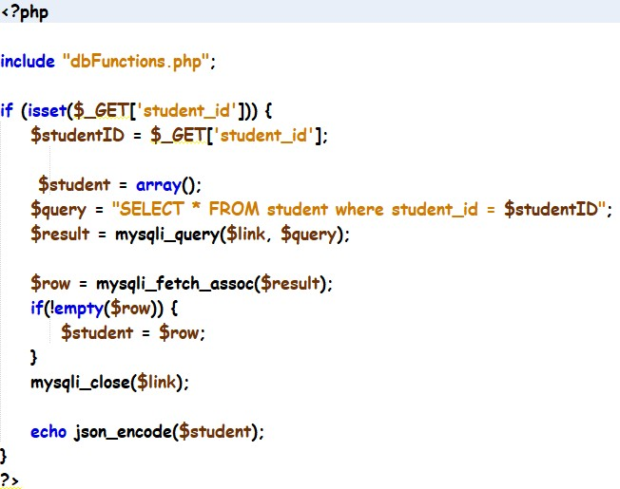
Exercise 3c: solution

Slide 29
AJAX with jQuery
The $.ajax(settings) or $.ajax(url, settings)
Used for sending an Ajax request. The settings is an object of key-value pairs:
url: The request URL
type: GET / POST.
data: Request parameters (name=value pairs). Can be expressed as an object (e.g., {name:"peter", msg:"hello"}), or query string (e.g., "name=peter&msg=hello").
dataType: Expected response data type, such as text, xml, json, script or html.
headers: an object for request header key-value pairs.

Slide 30
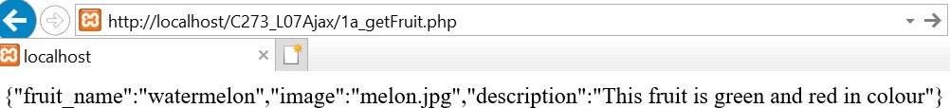
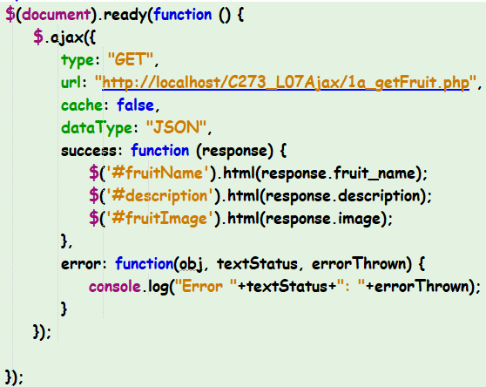

Exercise 4a
Step 1: AJAX initiates Http GET request and retrieves response as JSON message
Step 2: Retrieve data from object and display using jQuery selector

Slide 31
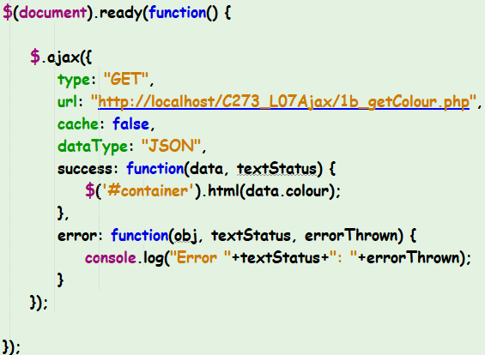
Exercise 4b
Write the jQuery code to make an ajax call to 1b_getColour.php and display the random colour in the “container”.

Slide 32
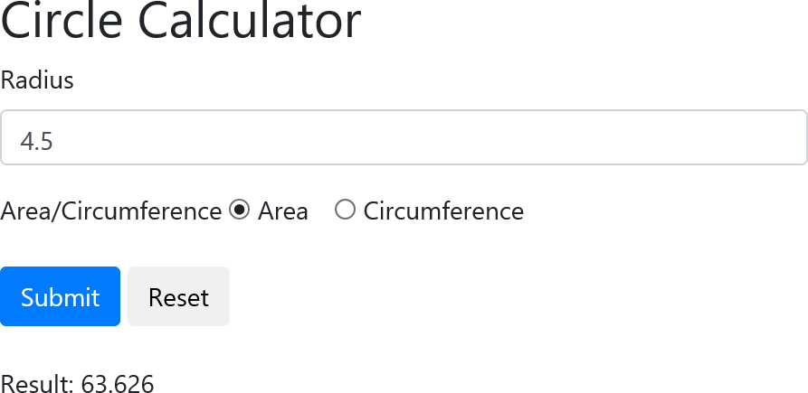
Exercise 4c
Make an ajax call to 1c_getCircleResults.php passing the “radius” and “type” as parameters (hint: use the “data” attribute in $.ajax)
Display the results from the JSON response in #results.

Slide 33
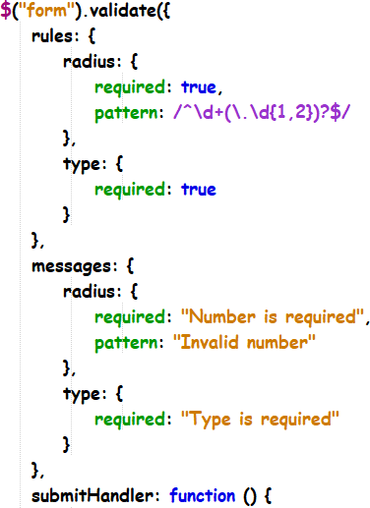
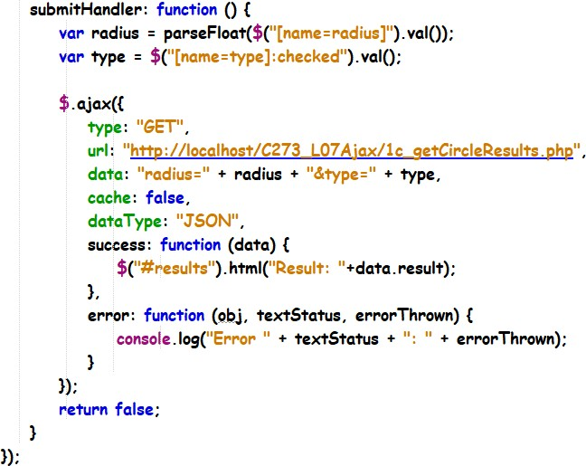
Exercise 4c: solution

Slide 34
What you learnt today
Identify the purpose of AJAX and how it is used
Demonstrate understanding of how AJAX works with JSON and PHP
Demonstrate understanding of json_encode function
Write a PHP webservice that retrieves data from MySQL database
Test the PHP webservice using the web browser

